Slide 1



AI & LLM with
2024 Summer Workshop
Dr. Timothy D.
Bowman "Dr. B"
Timothy D Bowman, PhD (Tim or Dr B) he/him/his
Associate Professor, The iSchool
tbowman@dom.edu
Phone: (708) 524-6653
Office Room: Crown 324,
7900 Division Street,
River Forest, IL 60305

Slide 2
Python Environments
A virtual environment is created on top of an existing Python installation, known as the virtual environment’s “base” Python, and may optionally be isolated from the packages in the base environment, so only those explicitly installed in the virtual environment are available.
Using conda to create virtual environments: https://docs.conda.io/projects/conda/en/4.6.0/user-guide/tasks/manage-environments.html
conda create --name <YOUR NAME>
Using venv to create virtual environments: https://docs.python.org/3/library/venv.html
python -m venv /path/to/new/virtual/<YOUR NAME>
REQUIREMENTS file
Must be in current directory you are working on
Inside requirements.txt file you list the modules you want to install (and you can specify versions!)
python3 -m pip install -r requirements.txt

Slide 3
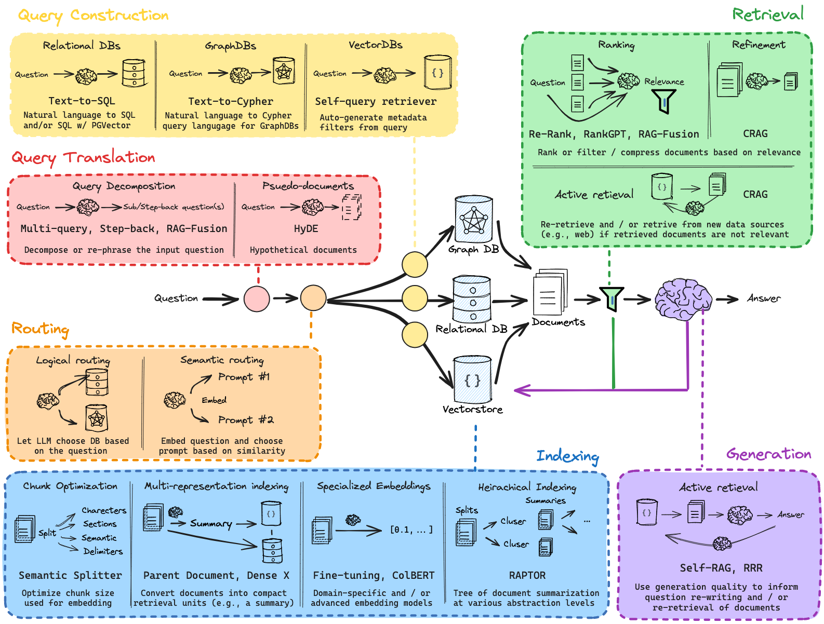
RAG – Retrieval Augmented Generation
https://github.com/langchain-ai/rag-from-scratch
https://www.youtube.com/watch?v=sVcwVQRHIc8

Slide 4

LangChain
A framework for developing applications powered by LLMs
Facilitates the creation of complex language-based workflows.
Simplifies building and scaling language model-powered applications.
Facilitates the integration of various AI models and tools.
https://www.langchain.com/
https://python.langchain.com/v0.2/docs/introduction/
https://python.langchain.com/v0.2/docs/tutorials/llm_chain/

Slide 5
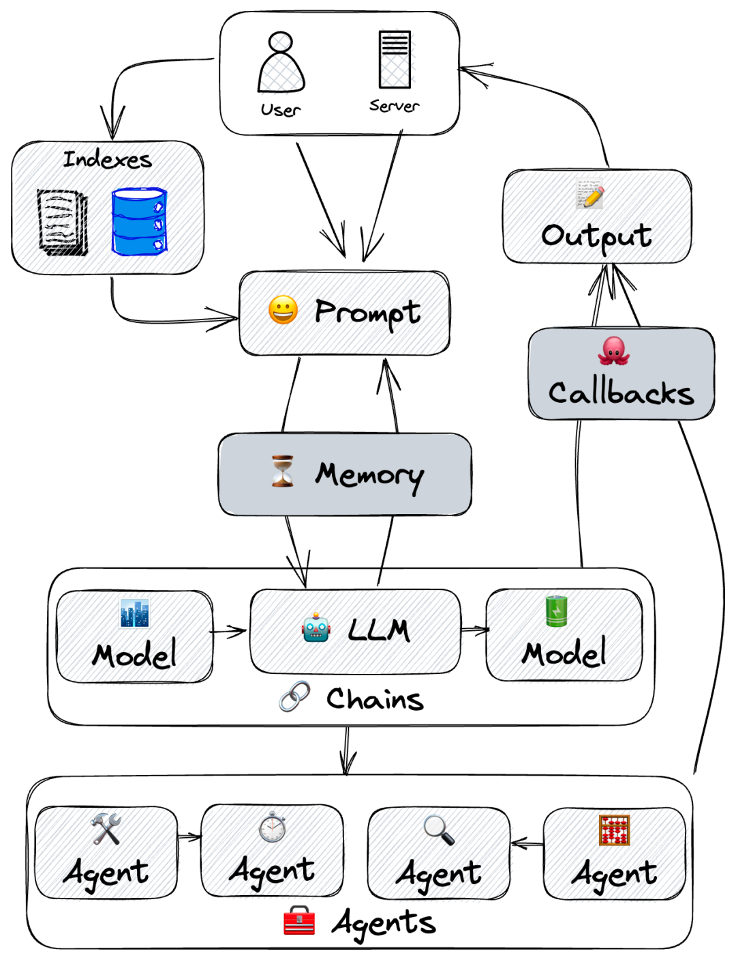
LangChain Key Points
https://medium.com/@ai-data-drive/langchain-series-01-what-is-it-dc2ae8db9edd
Core Components:
Chains: A sequence of calls to language models.
Agents: Autonomous programs that use language models to make decisions.
Tools: External tools like search engines or APIs that can be integrated with LangChain.
Modularity: Easily extendable and customizable.
Flexibility: Works with various data sources, models, and APIs.
* Access other data (such as enterprise or developer-owned data, various open source datasets, etc.).
* Interact with other systems or environments (such as search engines, Python compilers, math calculators, etc.) to realize various rich product functions.

Slide 6
LangChain Key Points
https://medium.com/@ai-data-drive/langchain-series-01-what-is-it-dc2ae8db9edd
Core Components:
Chains: A sequence of calls to language models.
Agents: Autonomous programs that use language models to make decisions.
Tools: External tools like search engines or APIs that can be integrated with LangChain.
Modularity: Easily extendable and customizable.
Flexibility: Works with various data sources, models, and APIs.
* Access other data (such as enterprise or developer-owned data, various open source datasets, etc.).
* Interact with other systems or environments (such as search engines, Python compilers, math calculators, etc.) to realize various rich product functions.

Slide 7
LangChain VERY Simple Example
from langchain.chains import SimpleChain
def simple_chain(input_text):
return input_text.upper()
# Example chain that converts text to uppercase
print(simple_chain("hello world"))

Slide 8
LangChain VERY Simple Q&A Bot
from transformers import pipeline
# Load a pre-trained model for question answering
model = pipeline("question-answering", model="distilbert-base-cased-distilled-squad") # Example usage
context = "LangChain is a framework for developing language model applications."
question = "What is LangChain?"
print(model(question=question, context=context)['answer'])

Slide 9
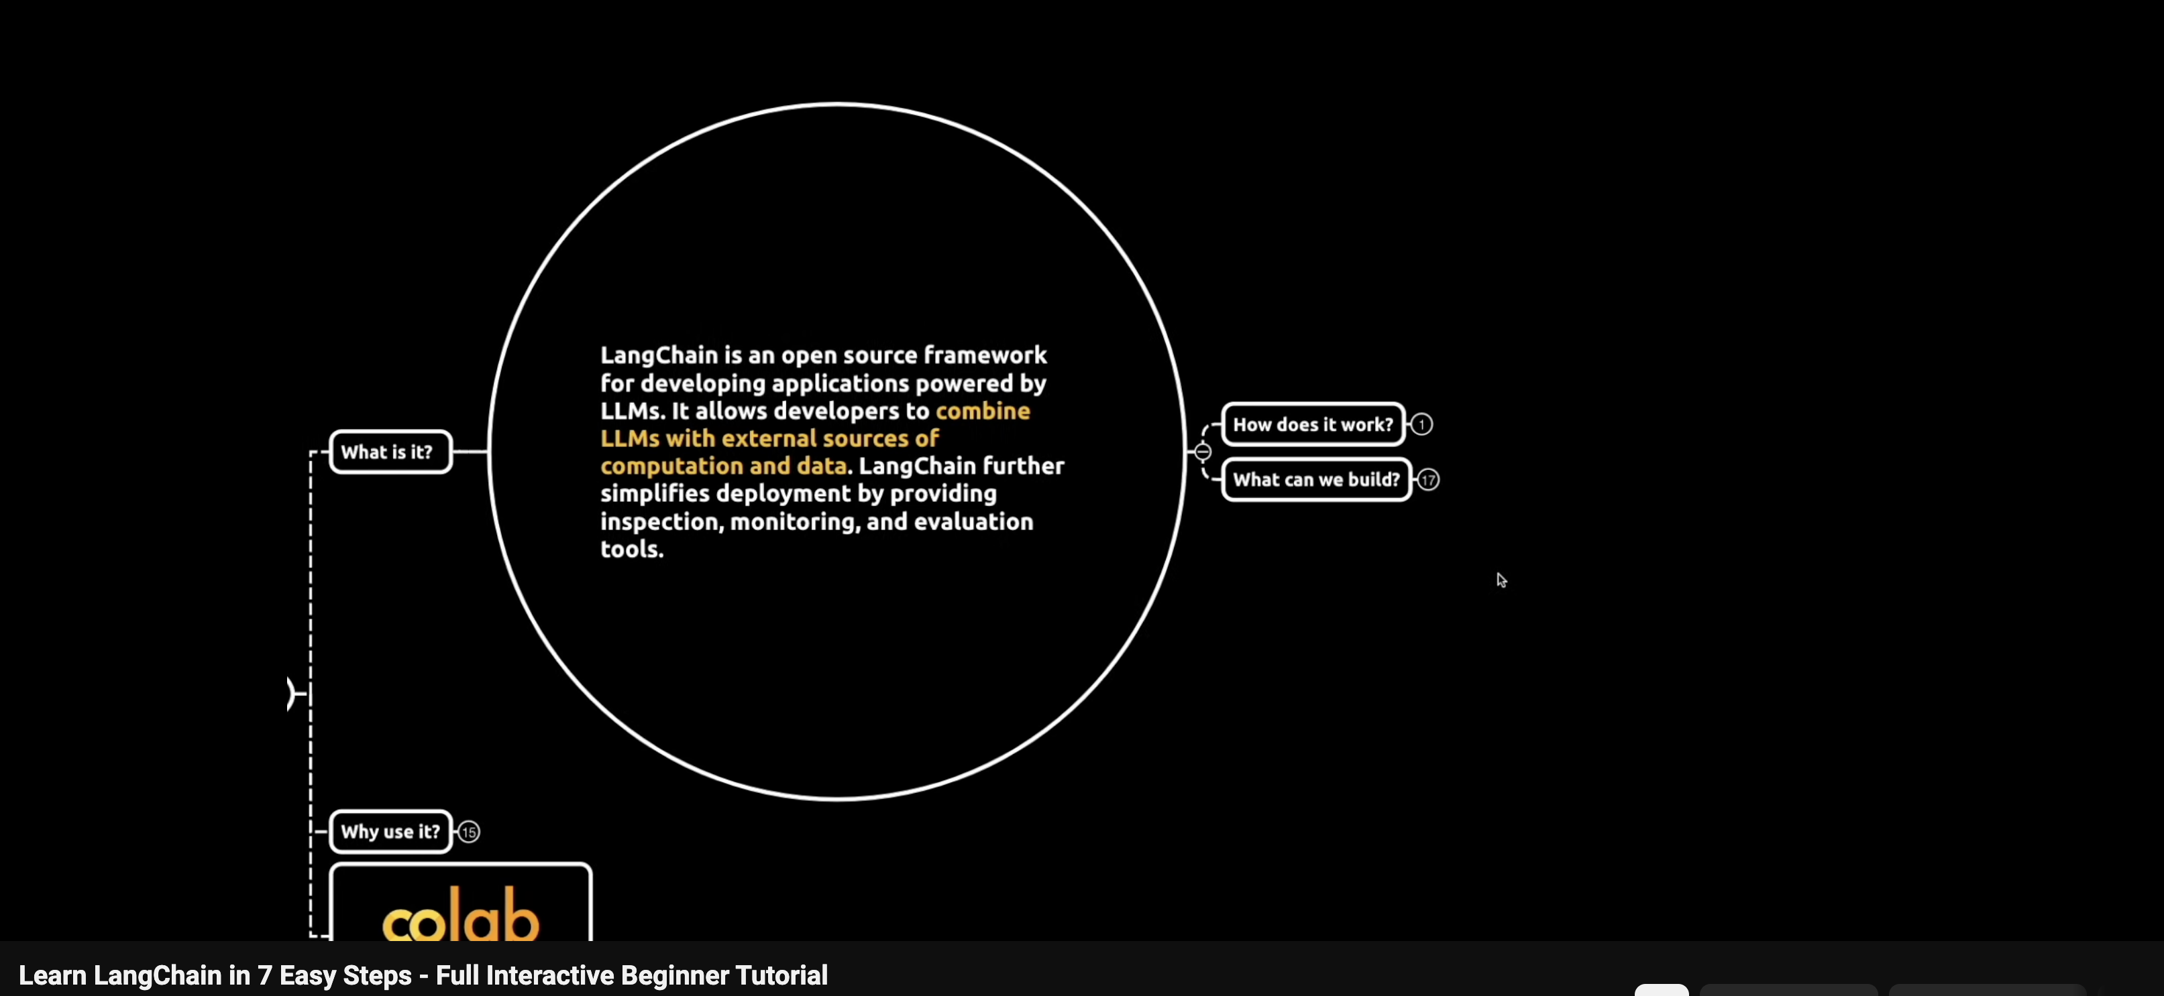
LangChain – Tutorial for Beginners
https://www.youtube.com/watch?v=8BV9TW490nQ

Slide 10

HuggingFace – transformers module
Transformers provides APIs and tools to easily download and train state-of-the-art pretrained models.
* Using pretrained models can reduce your compute costs, carbon footprint, and save you the time and resources required to train a model from scratch
Transformers support framework interoperability between PyTorch, TensorFlow, and JAX.
* This provides the flexibility to use a different framework at each stage of a model’s life; train a model in three lines of code in one framework, and load it for inference in another.
https://huggingface.co/docs/transformers/en/index

Slide 11
HuggingFace – pipeline
: a great and easy way to use models for inference
The pipeline abstraction is a wrapper around all the other available pipelines.
To iterate over full datasets it is recommended to use a dataset directly. This means you don’t need to allocate the whole dataset at once, nor do you need to do batching yourself.
Pipelines are made of:
A tokenizer in charge of mapping raw textual input to token.
A model to make predictions from the inputs.
Some (optional) post processing for enhancing model’s output.
https://huggingface.co/docs/transformers/en/main_classes/pipelines

Slide 12
HuggingFace – OpenLLM Leaderboard
https://huggingface.co/spaces/open-llm-leaderboard/open_llm_leaderboard
IFEval – IFEval is a dataset designed to test a model’s ability to follow explicit instructions, such as “include keyword x” or “use format y.”
BBH (Big Bench Hard)– A subset of 23 challenging tasks from the BigBench dataset to evaluate language models. The tasks use objective metrics, are highly difficult, and have sufficient sample sizes for statistical significance. They include multistep arithmetic, algorithmic reasoning (e.g., boolean expressions, SVG shapes), language understanding (e.g., sarcasm detection, name disambiguation), and world knowledge. BBH performance correlates well with human preferences, providing valuable insights into model capabilities.
MATH – is a compilation of high-school level competition problems gathered from several sources, formatted consistently using Latex for equations and Asymptote for figures.
GPQA –is a highly challenging knowledge dataset with questions crafted by PhD-level domain experts in fields like biology, physics, and chemistry. These questions are designed to be difficult for laypersons but relatively easy for experts.
MuSR (Multistep Soft Reasoning) – is a new dataset consisting of algorithmically generated complex problems, each around 1,000 words in length. The problems include murder mysteries, object placement questions, and team allocation optimizations. Solving these problems requires models to integrate reasoning with long-range context parsing. Few models achieve better than random performance on this dataset.
MMLU-PRO (Massive Multitask Language Understanding - Professional) –is a refined version of the MMLU dataset, which has been a standard for multiple-choice knowledge assessment. Recent research identified issues with the original MMLU, such as noisy data (some unanswerable questions) and decreasing difficulty due to advances in model capabilities and increased data contamination. MMLU-Pro addresses these issues by presenting models with 10 choices instead of 4, requiring reasoning on more questions, and undergoing expert review to reduce noise.
https://ai.google.dev/responsible/docs/evaluation
https://pair-code.github.io/llm-comparator/
https://arxiv.org/html/2402.10524v1

Slide 13
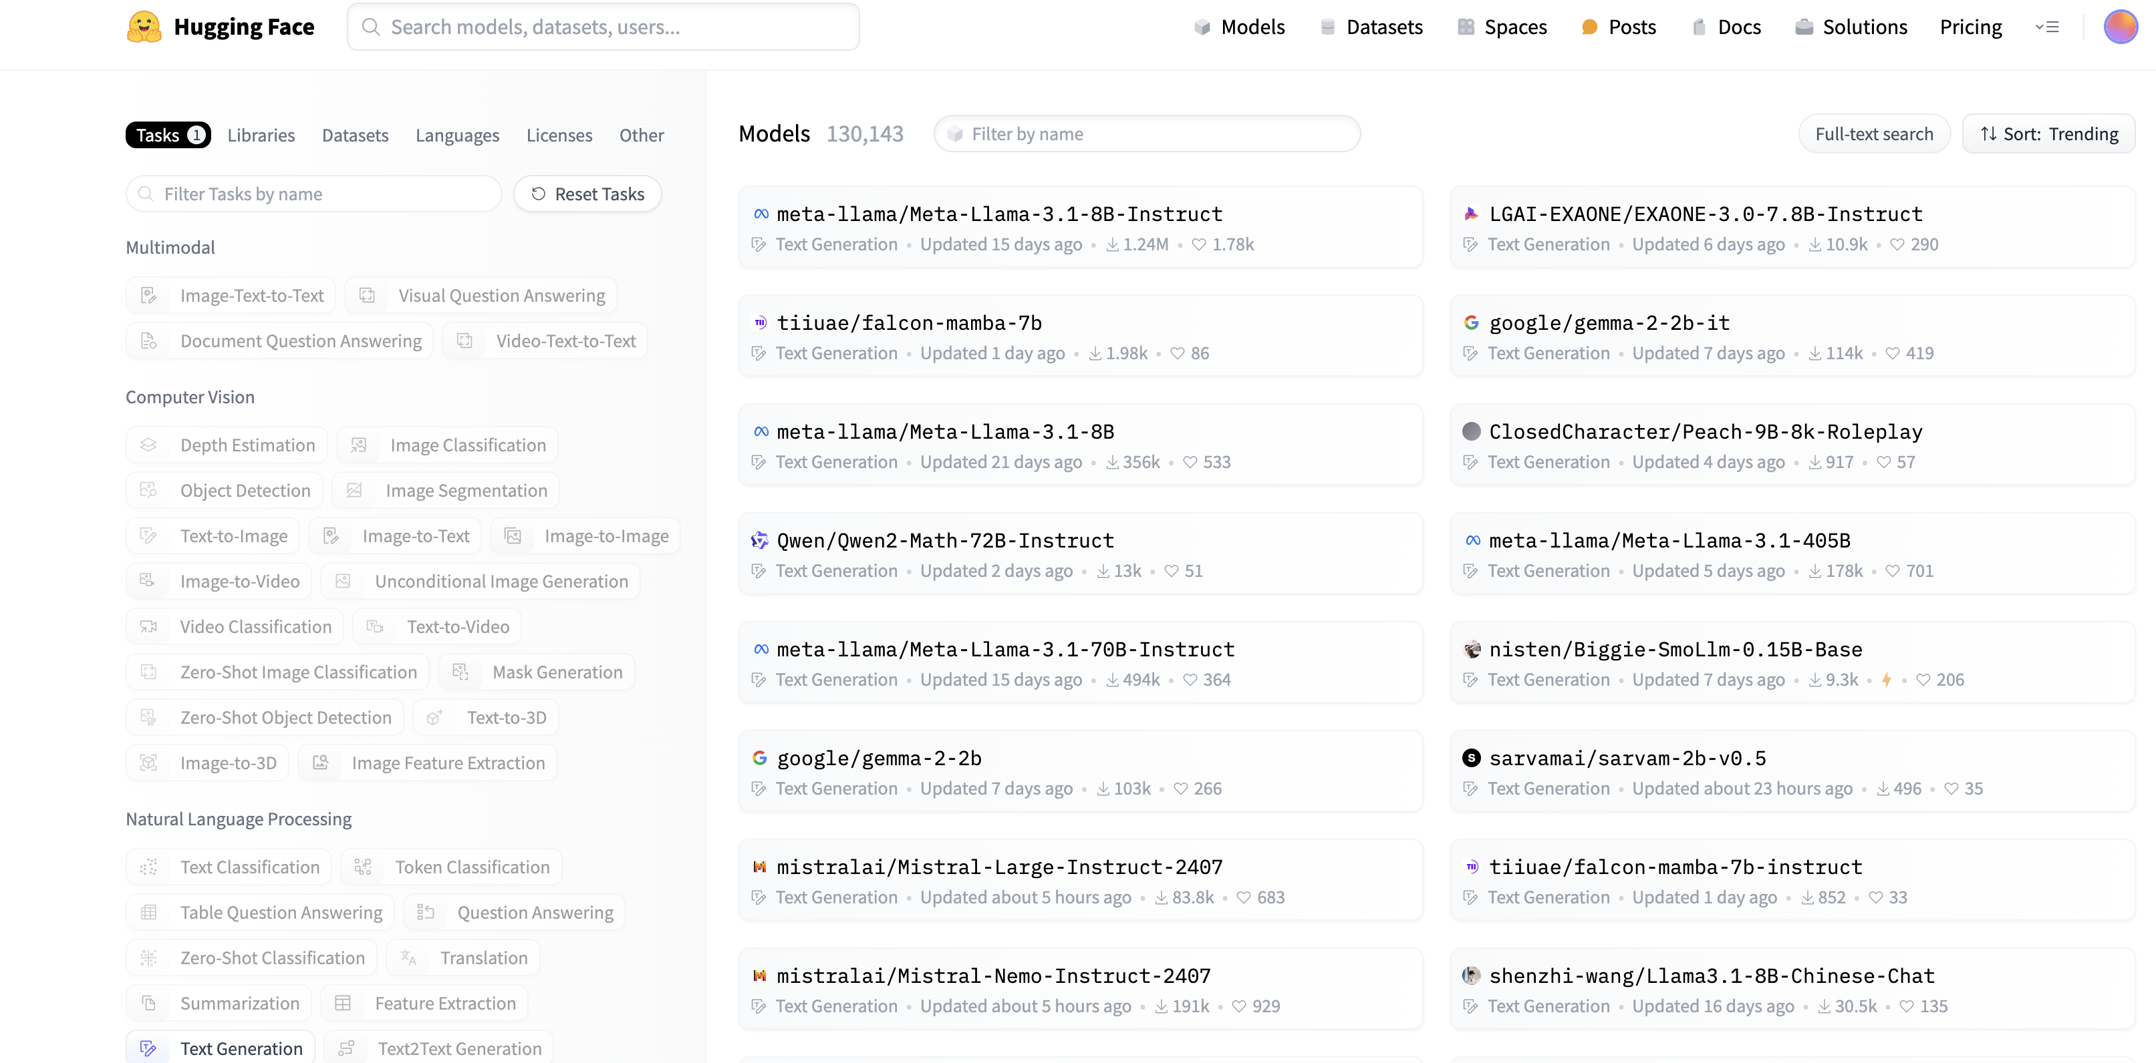
HuggingFace – MODEL Cards

Slide 14
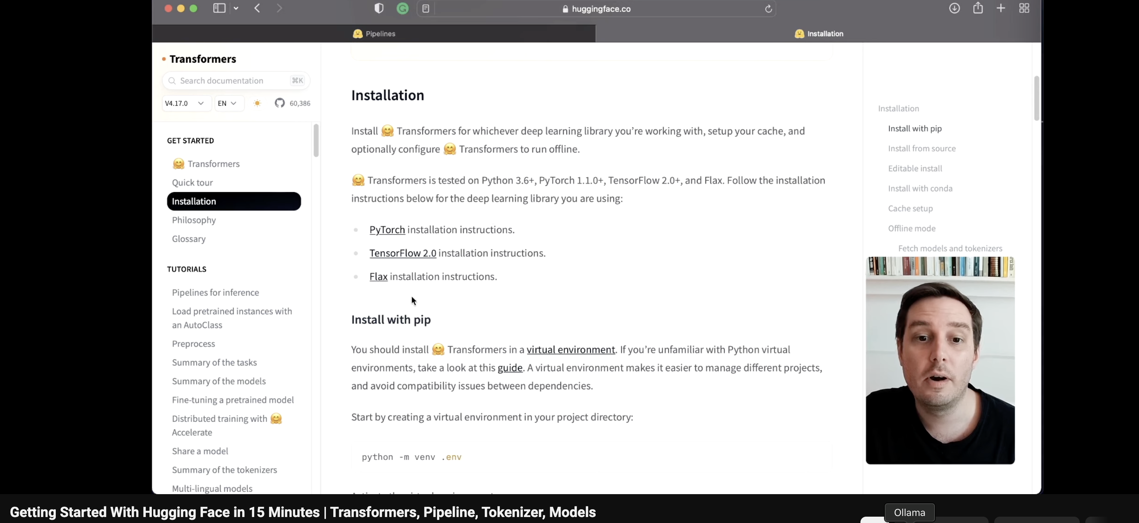
HuggingFace – Tutorial for Beginners
https://www.youtube.com/watch?v=QEaBAZQCtwE

Slide 15
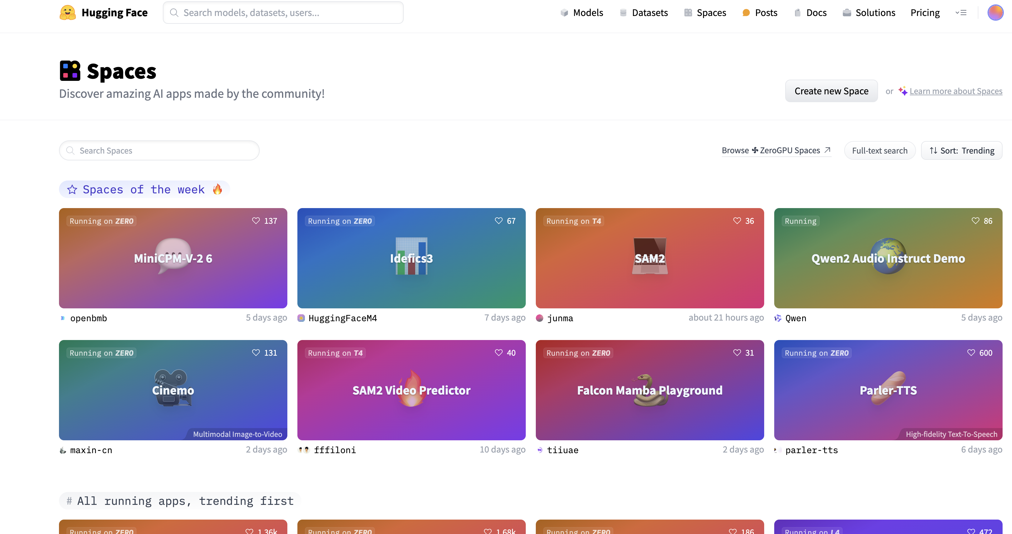
HuggingFace – Spaces
https://huggingface.co/spaces

Slide 16
Resources
Task Summaries (Colab): - https://colab.research.google.com/github/huggingface/notebooks/blob/main/transformers_doc/en/task_summary.ipynb#scrollTo=UES3W86QG7m-
Builing NLP Pipelines with HuggingFace: https://towardsdatascience.com/build-nlp-pipelines-with-huggingface-datasets-d597ff5f68ad
Simple RAG for GitHub issues: https://huggingface.co/learn/cookbook/rag_zephyr_langchain
RAG app for Speckly issues: https://github.com/bhargobdeka/RAG-chatbot-Speckly
Building RAG Multi-modal System for Visual Question Answering: https://medium.com/gitconnected/building-a-multi-modal-rag-system-for-visual-question-answering-52b5b0979acb
Langchain Concept Guide: https://python.langchain.com/v0.2/docs/concepts/
OpenSource Models GenAI (colab): https://www.youtube.com/watch?v=3fyazg9-n2o https://colab.research.google.com/drive/1tbNU3sT375kwDPm6jEpwp9KiORmsGcrU#scrollTo=Olq24pYGUIpZ

